Slide 1
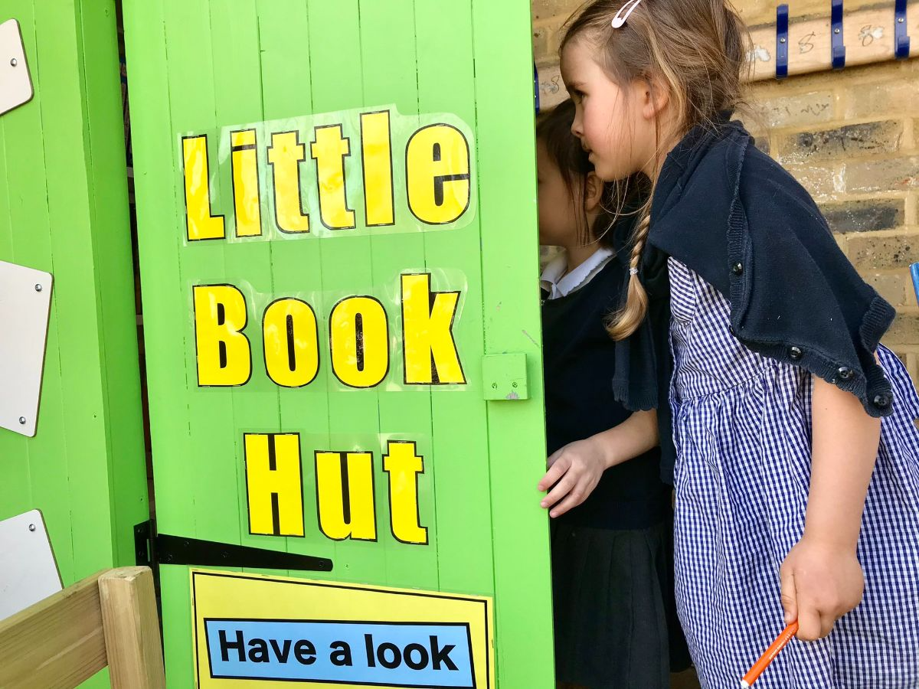
www.childrensbookproject.co.uk

Slide 2
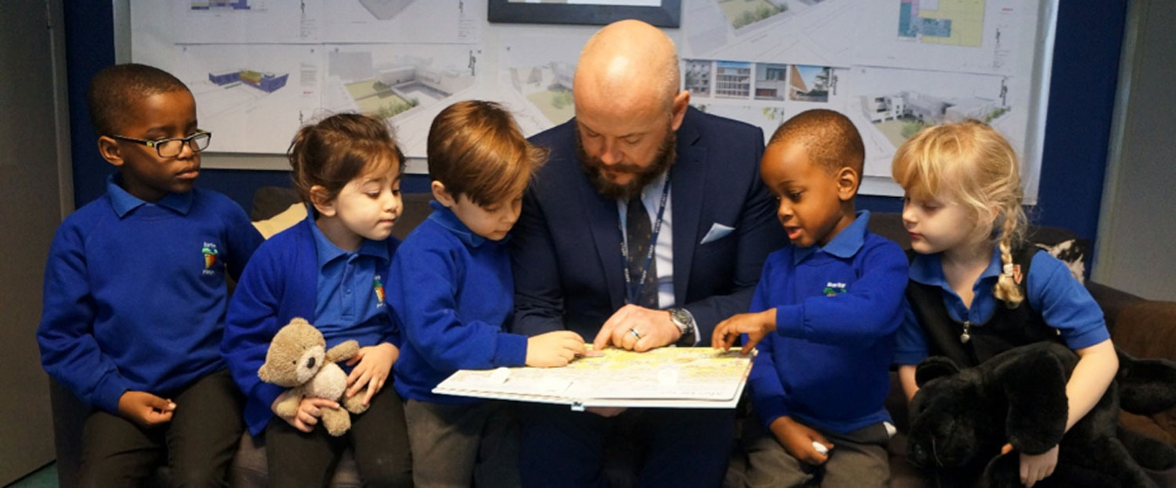
We are collecting books on behalf of the Children's Book Project.
Every book donated will support our local community.

Slide 3
EVERY BOOK GIFTED WILL BE DONATED TO A CHILD WITH FEW OF THEIR OWN

Slide 4
Help us to tackle book poverty across our local community.
1 in 8 children in receipt of free school meals has no books of their own.
1 in 4 has fewer than 10 books.
"This gifting programme shows our children that they deserve to own a book".
Head Teacher, West London

Slide 5
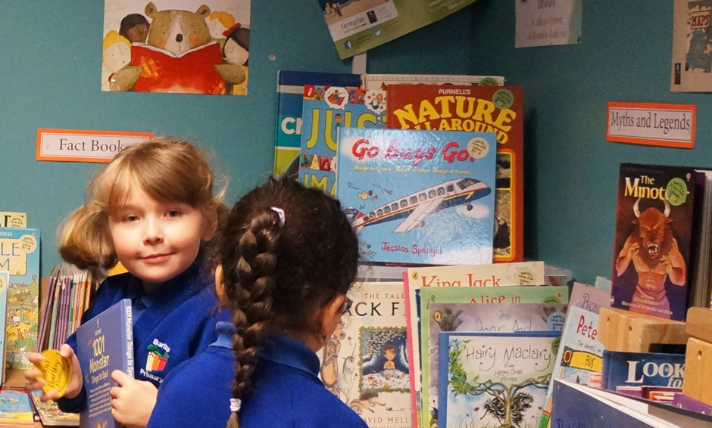
THE CHARITY PUTS ON CELEBRATORY BOOK GIFTING EVENTS

Slide 6
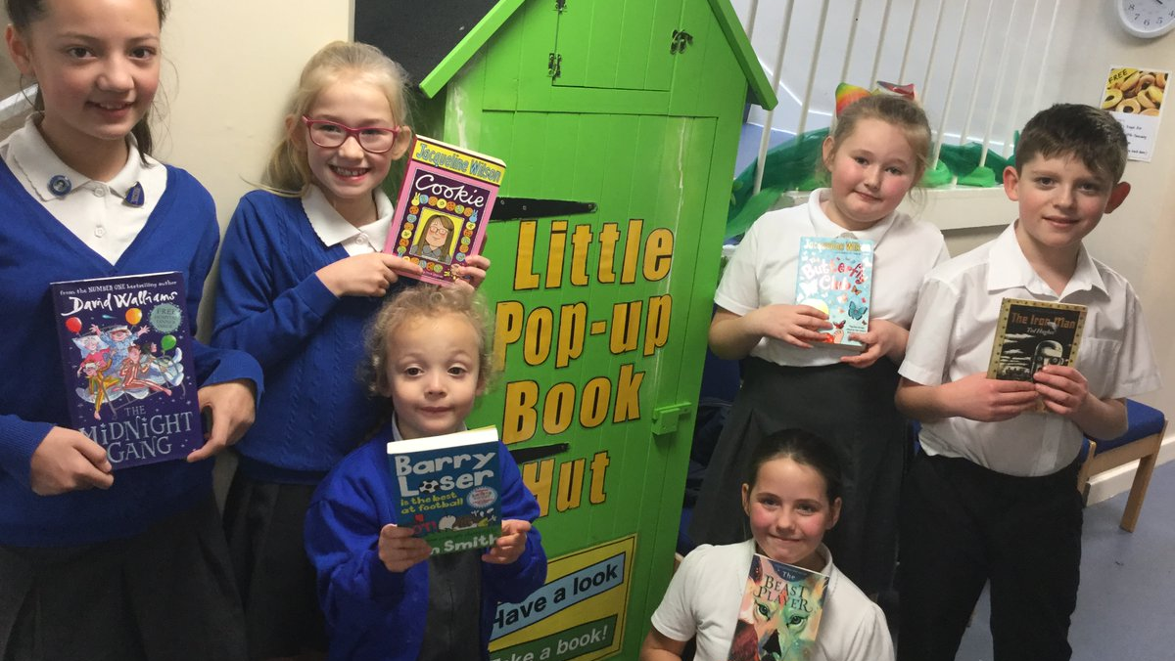
AND REACHES CHILDREN VIA SCHOOLS, FOOD BANKS, PRISONS AND WOMEN'S GROUPS

Slide 8
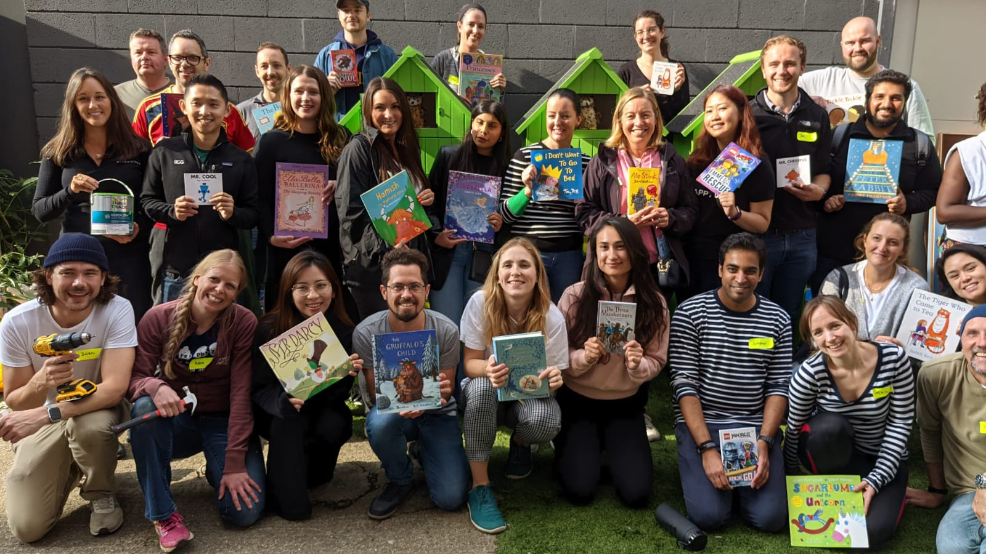
SO PLEASE BRING IN YOUR BOOKS AND HELP US MAKE A REAL DIFFERENCE!

